Slide 1
Outstanding performer selection 2023-2024
Mr. Tanmay Alone
Senior Project Associate – I
KLCDP-Solar

Slide 2













Core Technical Expertise

Slide 3
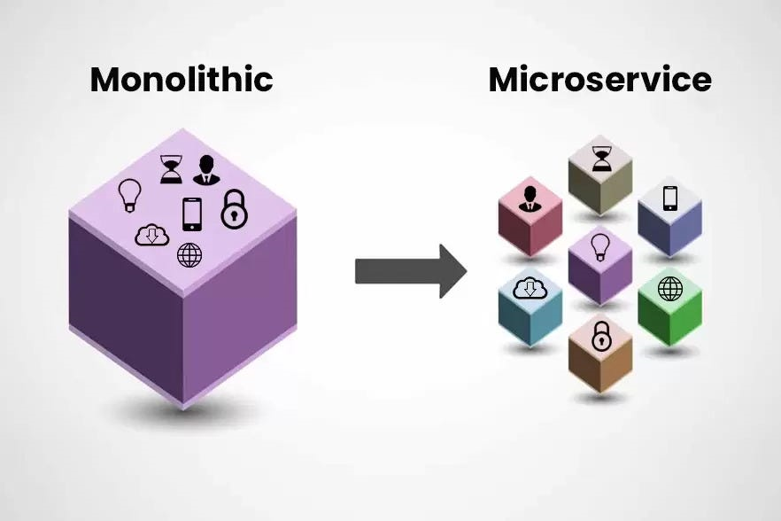
Need
Monolithic Architecture of Solar web application.
Shift to microservices challenges.
Centralized security control.
Single login.

Slide 4
Accomplishments & contributions

Slide 5
Accomplishments & contributions
Central Authentication Service (CAS).

Slide 6

Central Authentication Service (CAS)
Single sign-on protocol for authenticating users across multiple applications.
OAuth 2.0 Authorization protocol.
Support for various authentication methods under the OAuth 2.0 protocol
Authorization Code Flow.
Client Credentials Flow.
Integration with other external clients E.g. ERA and mobile applications.
Client specific customized token settings.
Role and Scope based Resource access control.

Slide 7
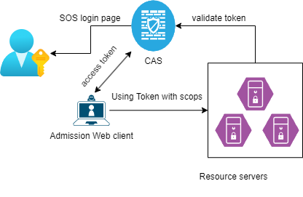
Authorization code flow of cas
Used by Web client application servers or mobile applications.
Implementation :-
Integration with solar client application.
Integration with Era client as a learner login.

Slide 8
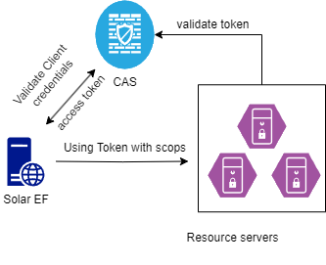
Client credentials flow of cas
Used for machine-to-machine communication.
Implementation:-
EF web server to new solar services.

Slide 9
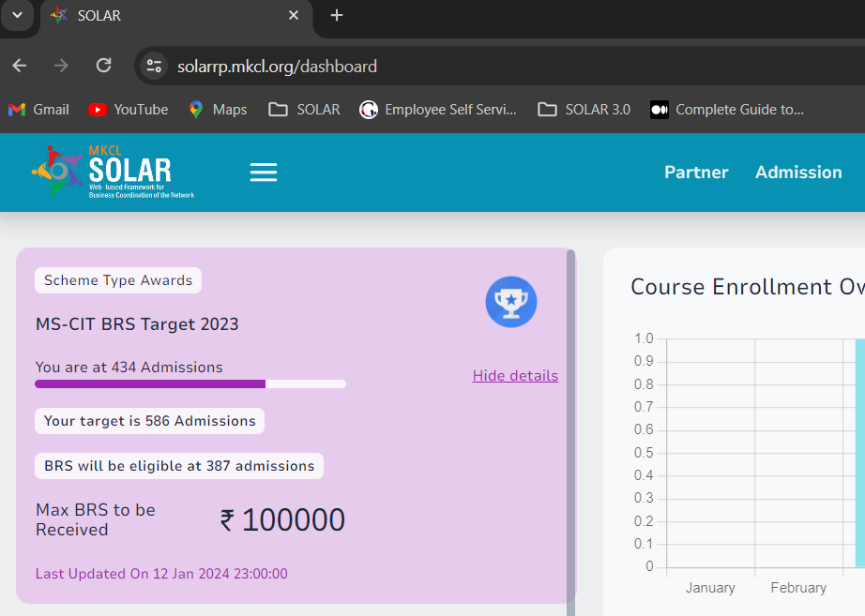
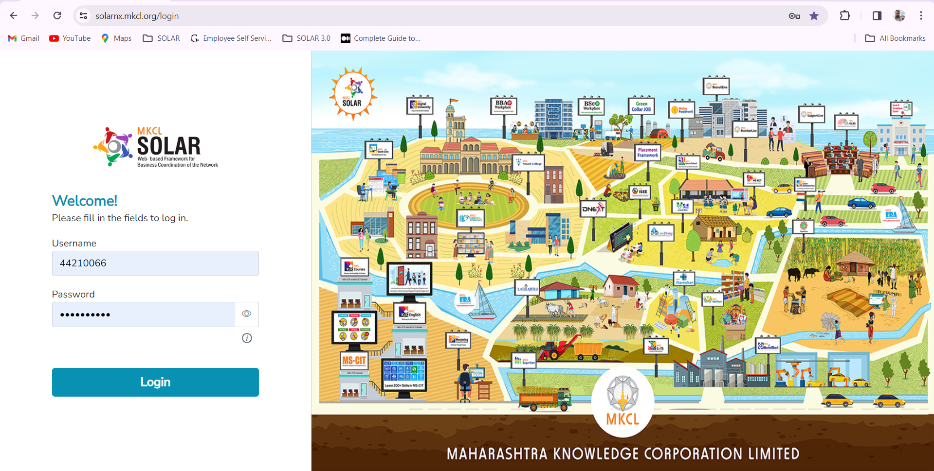
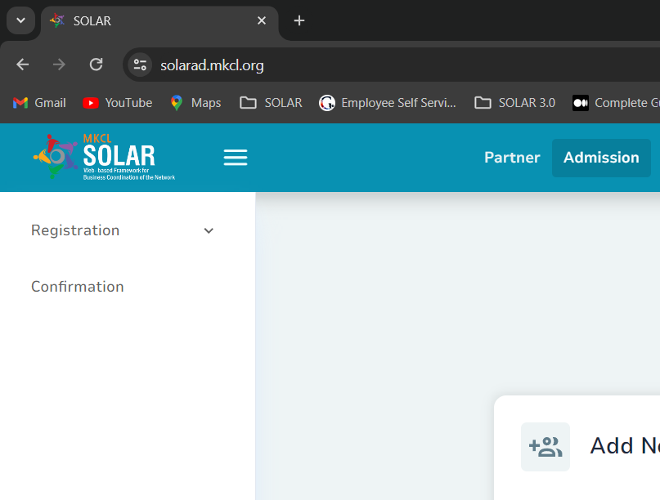
Implementation of cas for Partner login

Slide 10
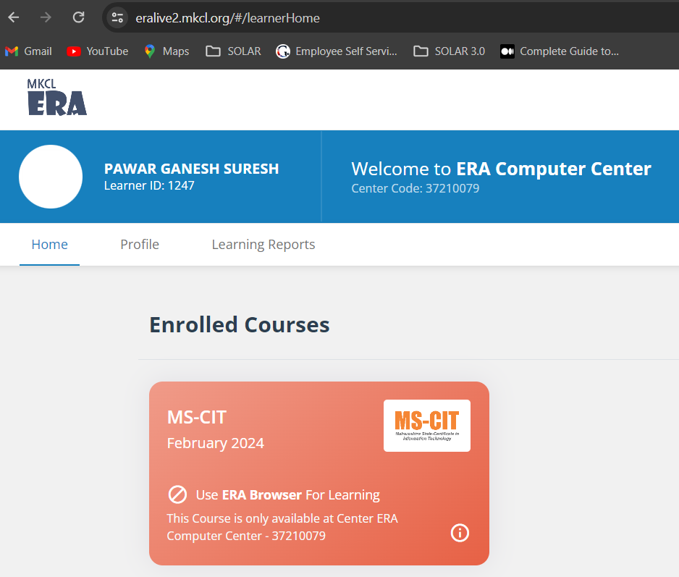
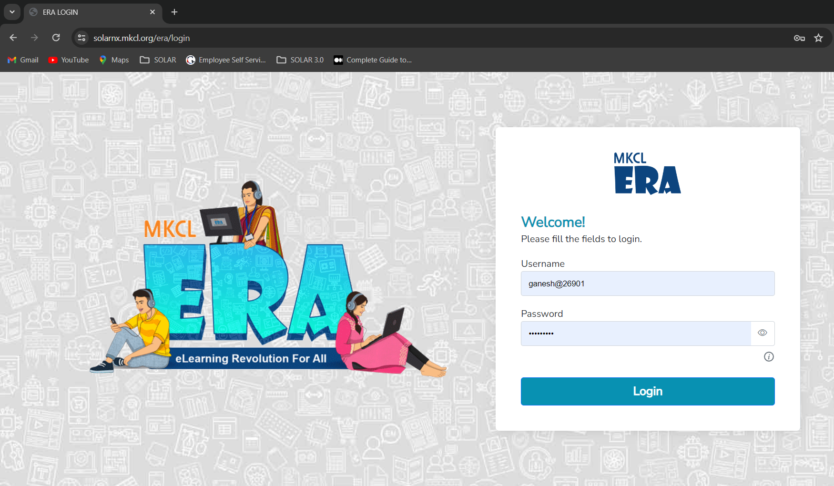
Implementation of cas for learner login in era

Slide 11
Positive Qualitative & Quantitative Impact

Slide 12

Central Cloud Configuration Service
Solution for centralized configuration management in Spring Boot applications
Externalized Configuration.
Environment-specific Configurations.
Dynamic Refresh.

Slide 13
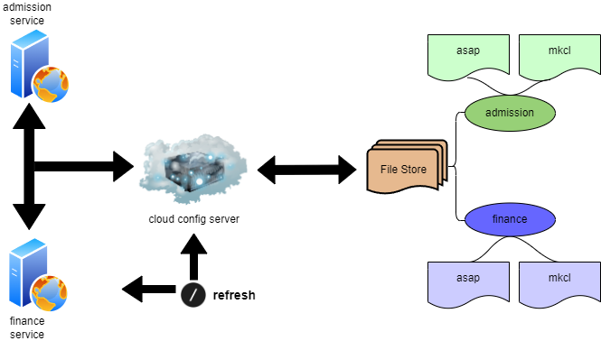
Architecture OF CLOUD CONFIG SERVICE

Slide 14
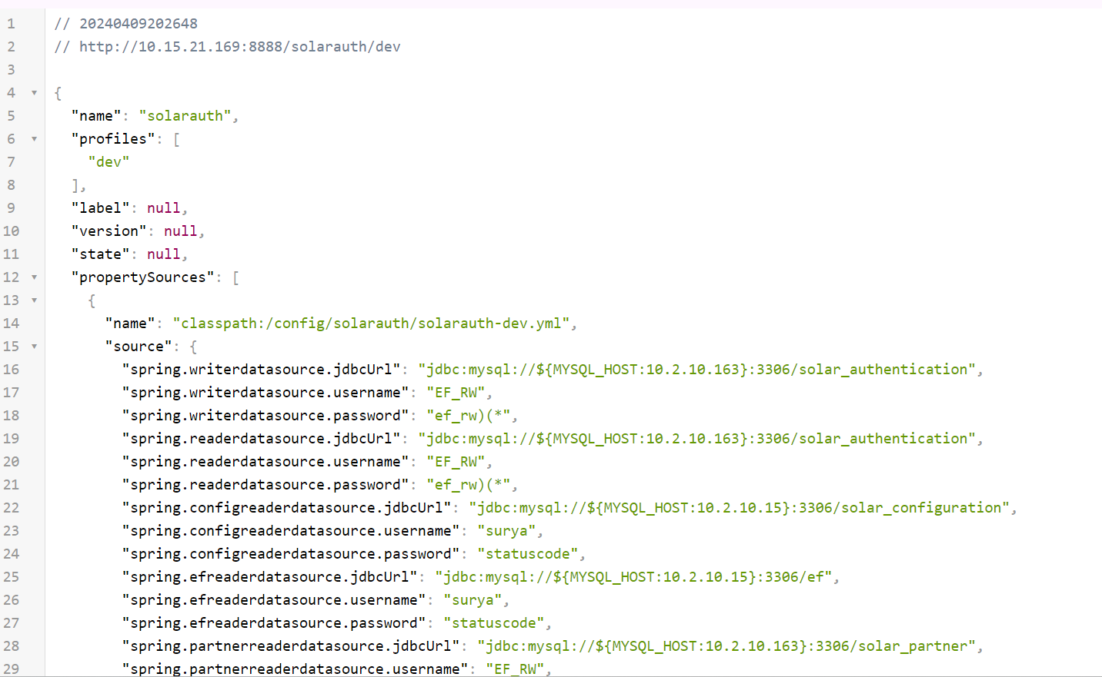
IMPLEMENTATION OF CLOUD CONFIG SERVICE
ASAP JV PROPERTIES FILE FOR AUTH SERIVE USING CLOUD CONFIG SERVICE

Slide 15
Specific Individual Contributions

Slide 16
My contributions
Self designed reusable components.
Architecture and DB modeling.
Prepared base for further development.
POC’s

Slide 17
Specific Contributions: Increase Productivity and Quality

Slide 18
Specific Contributions: Increase Productivity and Quality
PT-2024 recruitment drive.
Development of spring boot template for the team.
Solar optimization and improvement
Query optimization.
Automation and dashboard processing optimization.

Slide 19
Spring Boot template Server.
Generic spring boot service for developers to develop new microservice.
Features:
Based on latest technology of spring boot and Java-17.
Necessary and required imports and configuration
DB and connection pooling configuration.
Authentication & security filters chain configuration.
Application properties configuration using cloud configuration service.
Archival policy configuration.
Dummy CRUD implementation.
Generic Rest template handler.

Slide 20
Quantitative Impact
For developer takes 1 weeks just to create new template now using spring boot template server it is one day task.
Now from one template servers 10 microservices are created and running on production.
Admission
Finance
Template
Partner
Report

Slide 21
Initiatives Taken Beyond Assigned Responsibilities
Shifting project from SVN to GIT prepared documentation conducted session for that .
Conducted session of spring boot template server.

Slide 22
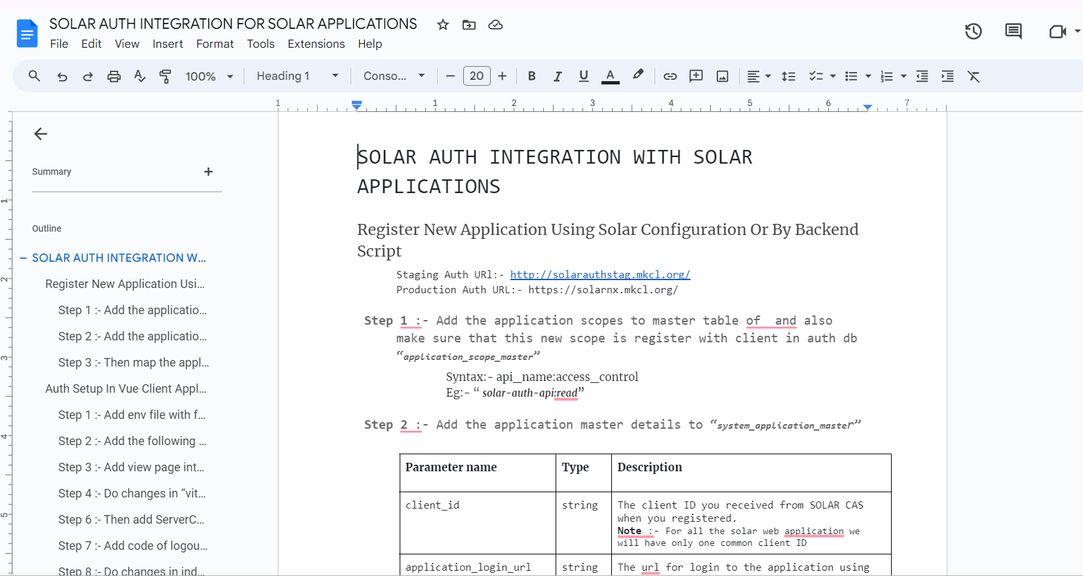
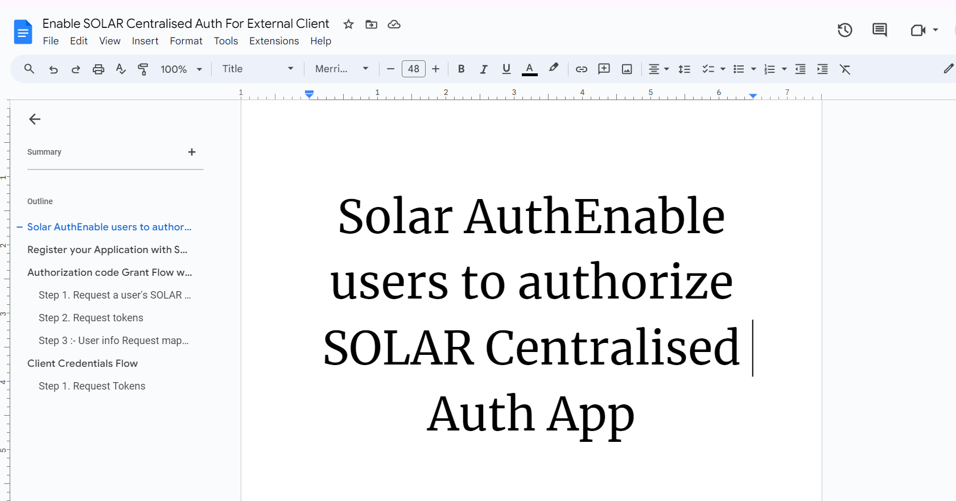
Documentation OF Central Authentication Service

Slide 23
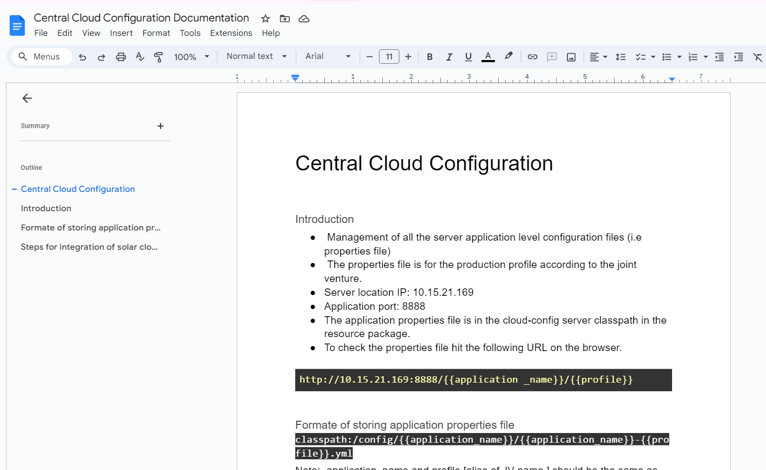
Documentation OF Central Cloud Configuration Service

Slide 24
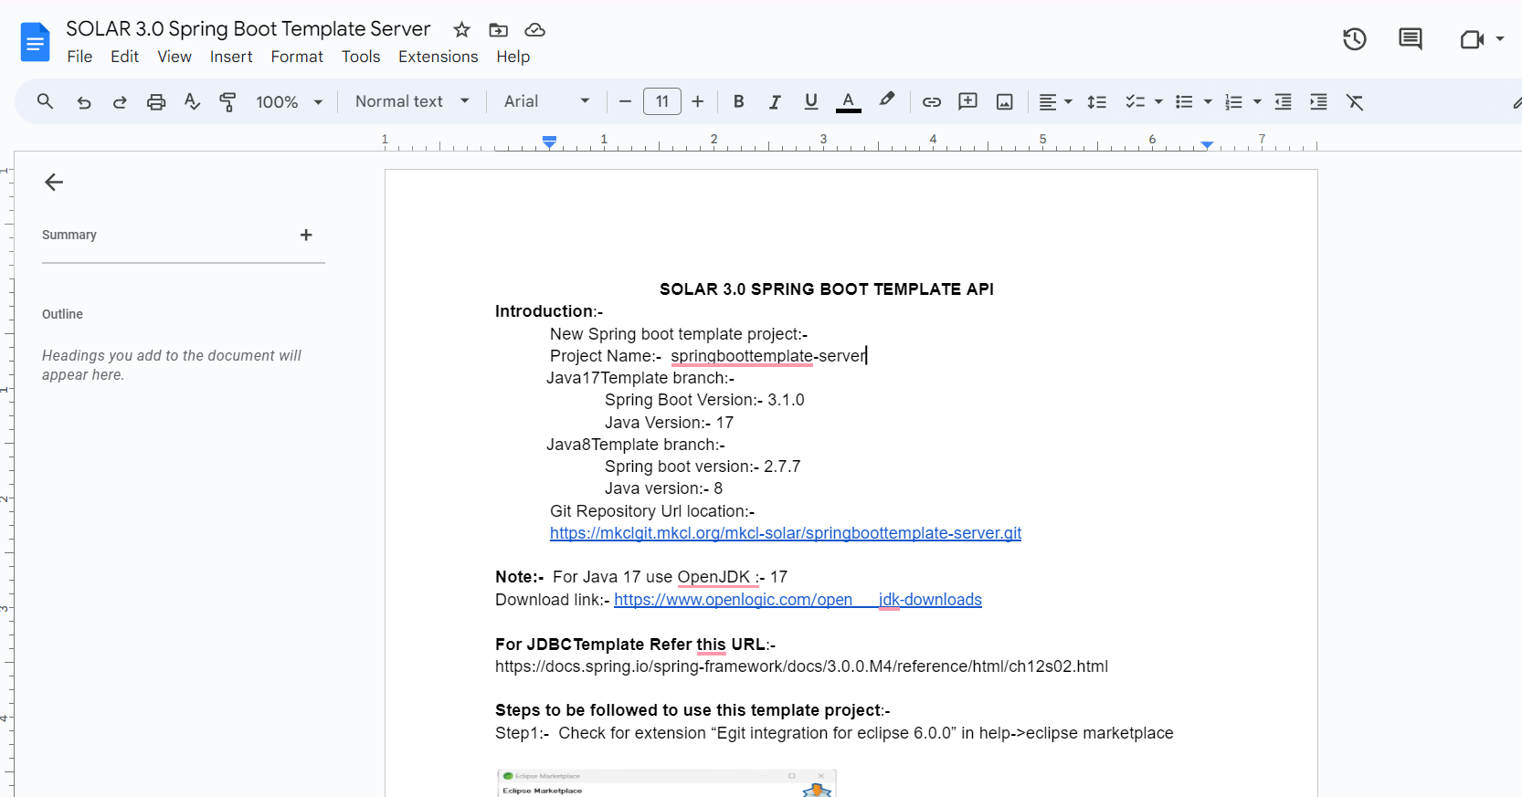
Documentation of Spring Boot template Server

Slide 25
Learning and certification
Java-17.
Microservices with spring boot and spring cloud.
Spring security 6 and security filter chain.
oAuth2.0.
Google cloud basics
Ref:-
https://docs.spring.io/spring-security/reference/whats-new.html
https://spring.io/projects/spring-authorization-server
https://oauth.net/2/
https://spring.io/projects/spring-cloud-config

Slide 26
Thank you

